Slide 1
Graph Coloring and Applications
Presented by
Adam Cramer

Slide 2
Overview
Graph Coloring Basics
Planar/4-color Graphs
Applications
Chordal Graphs
New Register Allocation Technique

Slide 3
Basics
Assignment of "colors" to certain objects in a graph subject to certain constraints
  Vertex coloring (the default)
  Edge coloring
  Face coloring (planar)
Notes:
an edge coloring assigns a color to each edge so that no two incident edges share the same color, and a face coloring of a planar graph assigns a color to each face or region so that no two faces that share a boundary share the same color
Unless otherwise specified, vertex coloring is assumed

Slide 4
Not Graph Labeling
Graph coloring
  Just markers to keep track of adjacency or incidence
Graph labeling
  Calculable problems that satisfy a numerical condition
Notes:
Graph coloring is not to be confused with graph labeling, which is an assignment of labels, usually also in the form of numbers, to vertices or edges. In graph coloring problems, colors (e.g. 1, 2, 3...) are nothing more than markers for keeping track of adjacency or incidence. In graph labeling problems, labels (e.g. 1, 2, 3...) are calculable values that need to satisfy a certain numerical condition in the definition of the labeling.

Slide 5
Vertex coloring
In its simplest form, it is a way of coloring the vertices of a graph such that no two adjacent vertices share the same color
Edge and Face coloring can be transformed into Vertex version
Notes:
an edge coloring of a graph is just the vertex coloring of its line graph, and a face coloring of a planar graph is just the vertex coloring of its (planar) dual.

Slide 6
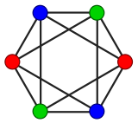
Vertex Color example
Anything less results in adjacent vertices with the same color
  Known as “proper”
3-color example

Slide 7
Vertex Color Example
1
2
3
4
5

Slide 8
Vertex Color Example
1
2
3
4
5

Slide 9
Chromatic Number
χ - least number of colors needed to color a graph
  Chromatic number of a complete graph:
  χ(K_{n}) = n
Notes:
Complete graph has an edge between every two vertices

Slide 10
Properties of χ(G)
χ(G) = 1 if and only if G is totally disconnected
χ(G) ≥ 3 if and only if G has an odd cycle (equivalently, if G is not bipartite)
χ(G) ≥ ω(G) (clique number)
χ(G) ≤ Δ(G)+1 (maximum degree)
χ(G) ≤ Δ(G) for connected G, unless G is a complete graph or an odd cycle (Brooks' theorem).
χ(G) ≤ 4, for any planar graph
  The “four-color theorem”
Notes:
Degree = the number of edges incident to v, with loops being counted twice.

Slide 11
Four-color Theorem
Dates back to 1852 to Francis Guthrie
Any given plane separated into regions may be colored using no more than 4 colors
  Used for political boundaries, states, etc
  Shares common segment (not a point)
Many failed proofs
Notes:
states that given any plane separated into regions, such as a political map of the states of a country, the regions may be colored using no more than four colors in such a way that no two adjacent regions receive the same color
First major theorem to be proven using a computer, and the proof is not accepted by all mathematicians because it would be unfeasible for a human to verify by hand

Slide 12
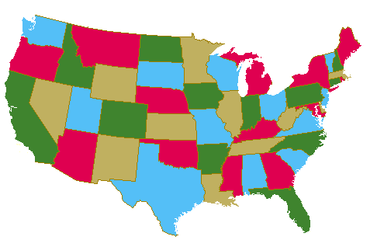
Four-color Theorem

Slide 13
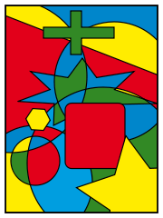
Four-color Theorem

Slide 14
Algorithmic complexity
Finding minimum coloring: NP-hard
Decision problem:
“is there a coloring which uses at most k colors?”
Makes it NP-complete
Notes:
It remains NP-complete even on planar graphs of degree at most 4, as shown by Garey and Johnson in 1974^{[1]}, although on planar graphs it's trivial for k > 3 (due to the four color theorem). There are however some efficient approximation algorithms
The case k = 2 is equivalent to determining whether or not the graph is bipartite. This can be accomplished in polynomial time. For k >= 3 the problem is NP-Complete. By the gap theorem, this implies that the problem can not be approximated by a polynomial algorithm within a factor of 4/3 unless P=NP.

Slide 15
Coloring a Graph - Applications
Sudoku
Scheduling
Mobile radio frequency assignment
Pattern matching
Register Allocation

Slide 16
Register Allocation with Graphs Coloring
Register pressure
  How determine what should be stored in registers
  Determine what to “spill” to memory
Typical RA utilize graph coloring for underlying allocation problem
  Build graph to manage conflicts between live ranges
Notes:
Colors used to show when cannot share same register
Better way to do RA with graphs

Slide 17
Chordal Graphs
Each cycle of four or more nodes has a chord
Subset of perfect graphs
Also known as triangulated graphs
Notes:
graph is chordal if each of its cycles of four or more nodes has a chord, which is an edge joining two nodes that are not adjacent in the cycle.

Slide 18
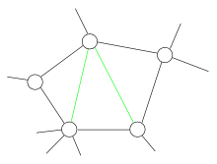
Chordal Graph Example
Removing a green edge will make it non-chordal
Notes:
A cycle (black) with two chords (green). As for this part, the graph is chordal. However, removing one green edge would result in a non-chordal graph. Indeed, the other green edge with three black edges would form a cycle of length four with no chords.

Slide 19
RA with Chordal Graphs
Normal register allocation was an NP-complete problem
  Graph coloring
If program is in SSA form, it can be accomplished in polynomial time with chordal graphs!
  Thereby decreasing need for registers

Slide 20
Quick Static Single Assignment Review
SSA Characteristics
  Basic blocks
  Unique naming for variable assignments
  Φ-functions used at convergence of control flows
Improves optimization
  constant propagation
  dead code elimination
  global value numbering
  partial redundancy elimination
  strength reduction
  register allocation

Slide 21
RA with Chordal Graphs
SSA representation needs fewer registers
Key insight: a program in SSA form has a chordal interference graph
  Very Recent
Notes:
Programs in SSA form need the same or smaller number of registers than that of the original program
The key insight is that a program in SSA form has a chordal interference graph..

Slide 22
RA with Chordal Graphs cont
Result is based on the fact that in strict-SSA form, every variable has a single contiguous live range
Variables with overlapping live ranges form cliques in the interference graph

Slide 23
RA with Chordal Graphs cont
Greedy algorithm can color a chordal graph in linear time
New SSA-elimination algorithm done without extra registers
Result:
  Simple, optimal, polynomial-time algorithm for the core register allocation problem
Notes:
A greedy algorithm can optimally color a chordal graph in linear time in the number of edges. Completing the picture, Hack et al. have presented a new SSA-elimination algorithm that does not demand extra registers. The combined result is a simple, optimal, polynomial-time algorithm for a core register allocation problem. The new SSA-elimination algorithm of Hack et al. is essential because classical SSA elimination leads to an Npcomplete core register allocation problem, as shown by Palsberg and Pereira. Register allocation with spilling for SSA form remains NP-complete

Slide 24
Chordal Color Assignment
Algorithm: Chordal Color Assignment
Input: Chordal Graph G = (V, E), PEO σ
Output: Color Assignment f : V → {1… χG}
  For Integer : i ← 1 to |V| in PEO order
    Let c be the smallest color not assigned to a vertex in Ni(vi)
    f(vi) ← c
  EndFor
Notes:
The basic idea of an elimination order is that graph Gi+1 can be constructed from Gi by adding vi+1 to Vi and adding all edges belonging to Ni(vi+1) to Ei
A Perfect Elimination Order (PEO) is an elimination order that satisfies the property that Ni(vi) is a
clique in Gi.
A PEO for a chordal graph can be computed in O(|V| + |E|) time using Maximum Cardinality Search (MCS)

Slide 25
Conclusion
Graph Coloring
Chordal Graphs
New Register Allocation Technique
  Polynomial time

Slide 26
References
http://en.wikipedia.org
Engineering a Compiler, Keith D. Cooper and Linda Torczon, 2004
http://www.math.gatech.edu/~thomas/FC/fourcolor.html
An Optimistic and Conservative Register Assignment Heuristic for Chordal Graphs, Philip Brisk, et. Al., CASES 07
Register Allocation via Coloring of Chordal Graphs, Jens Palsberg, CATS2007

Slide 27
Questions?
Thank you

